Slide 1


Kidney Transplant Risk Communication Tool
___________________________________________________________________________________
KIDNEY Stage 2&3 Round 3 (SPLIT OUT COMPETING RISKS – Visualisations – A095140 – 260263 – v1.0 08-12-20
Notes:
FROM ROUND 1
Changed some wording
Removed “cumulative totals” from headers
Changed “competing risks” wording to “waiting time”
Changed separated competing risks curves
ROUND 3
Incorporates feedback from round 1 & 2
- line graphs for survival when showing live AND deceased together
Don’t show average dialysis data, it’s not useful
Wording changes to headers (removing source data sentence)
FROM NHS BT MEETING DEC 2020 –
Decision to use cox over fine and gray – meaning we display competing risks on the same display (again)

Slide 2
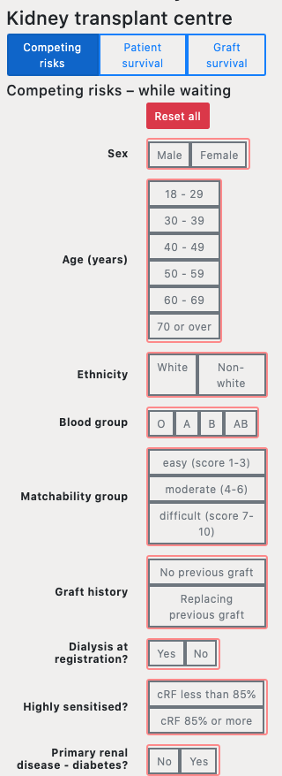
Input screen
Notes:
PATIENT #11 – wouldn’t have known ‘sensitised’ or ‘matchability’. Doesn’t think patients would know this information to be abe to use it alone

Slide 3
Waiting Time & chances of getting a transplant
Notes:
Changed “competing risks” wording to “waiting time”

Slide 4
Further information
Where did we get the data from?
To find out more about the data and models behind the calculator click here

Slide 5
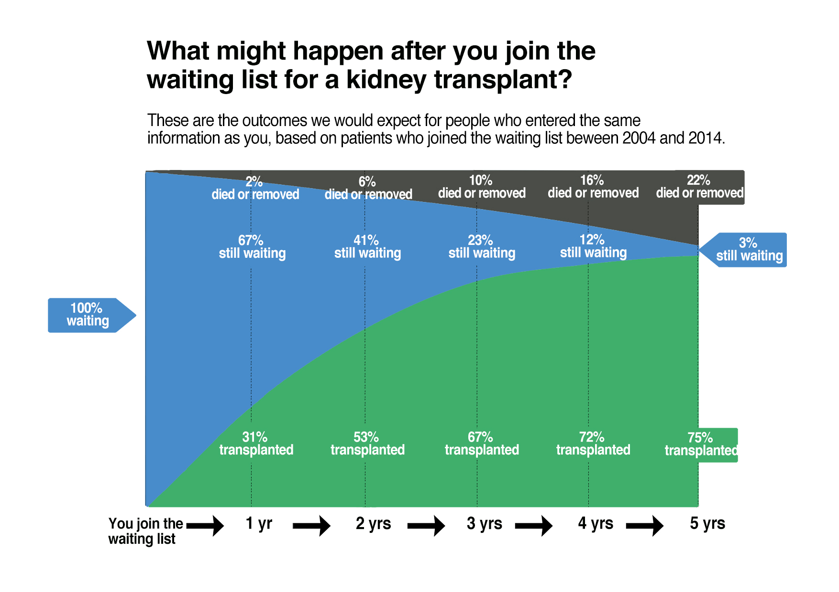
What might happen if you are listed for a LUNG transplant ?
This graph shows what happened to people ‘like you’ in the past (eg same blood group, age, disease etc.).
It shows how many people might be transplanted over 5 years
This is an estimate, an average, there are other factors about you that can influence these results and make the numbers higher or lower. eg whether you have other conditions not included in the tool
I I I I I I
day 1 by the end of by the end of by the end of by the end of by the end of
year 1 year 2 year 3 year 4 year 5
Notes:
Positive first impression – (7 or 9)
Negative first impression – (3) (it’s more complex)
Good once you get your head around it (2)
Can see overall picture / more nuanced – (2)
MAKE FONT BIGGER
MAKE SPACING OF FONT WIDER
SEE BLACK / DEAD PEOPLE FIRST – NOT GOOD (6) – CHANGE BLACK COLOUR OR MOVE BLACK TO BOTTOM
SHORTEN ALL WORDING
INCLUDE SCALE ON Y AXIS
TIDY UP ‘STICKY OUT BITS’ ON THE RIGHT

Slide 6
What might happen if you are listed for a LUNG transplant ?
This graph shows what happened to people ‘like you’ in the past (eg same blood group, age, disease etc.).
It shows how many people might be transplanted over 5 years
This is an estimate, an average, there are other factors about you that can influence these results and make the numbers higher or lower. eg whether you have other conditions not included in the tool
in year 1 | by the end of year 3 | by the end of year 5
10% have been transplanted | 23% have been transplanted | 73% have been transplanted
85% are still waiting | 67% are still waiting | 7% are still waiting
5% have died or been removed from the list | 10% have died or been removed from the list | 20% have died or been removed from the list
Notes:
Version 3 – Round 3 – Table – Competing Risks
Kidney “died / removed”
Round 2 – removed “these are cumulative totals” wording – 14/10/20

Slide 7
What might happen if you are listed for a LUNG transplant ?
This graph shows what happened to people ‘like you’ in the past (eg same blood group, age, disease etc.).
It shows how many people might be transplanted over 5 years
This is an estimate, an average, there are other factors about you that can influence these results and make the numbers higher or lower. eg whether you have other conditions not included in the tool
By the end of
Year 1
By the end of
Year 3
By the end of
Year 5
10% transplanted
23 %
transplanted
75 %
transplanted
85 %
still waiting
67 %
still waiting
10 % still waiting
5% Died or removed
10% Died or removed
15% Died or removed
Notes:
Version 3 – Round 3 – Bar Chart – Competing Risks
P11
Changed years to year 1, 3 and 5 to marry with the other examples
Changed “age, disease etc” to “e.g. age, disease, blood group”
Changed the numbers to more like kidney numbers (patients become influenced / affected by the outcomes so better to show
Round 2
Removed “these are cumulative totals”

Slide 8
What might happen if you are listed for a LUNG transplant ?
After 1 year 31 to have received a transplant
67 to still be waiting for a transplant
2 to have died or been removed from the list
After 2 years 67 to have received a transplant
23 to still be waiting for a transplant
10 to have died or been removed from the list
After 3 years 75 to have received a transplant
3 to still be waiting for a transplant
22 to have died or been removed from the list
This graph shows what happened to people ‘like you’ in the past (eg same blood group, age, disease etc.).
It shows how many people might be transplanted over 5 years
This is an estimate, an average, there are other factors about you that can influence these results and make the numbers higher or lower. eg whether you have other conditions not included in the tool
Notes:
P11
Thought when reading “100 transplant patients” that you want to know actually how many there are.
Need to re-word frequencies
Re-worded to
“Out of 100 kidney transplant patients who input the same characteristics as you, from the point of joining the waiting list, we would expect:

Slide 9
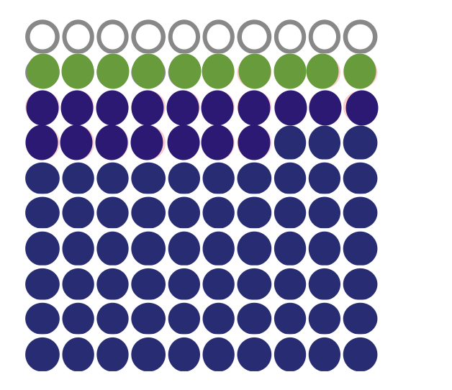
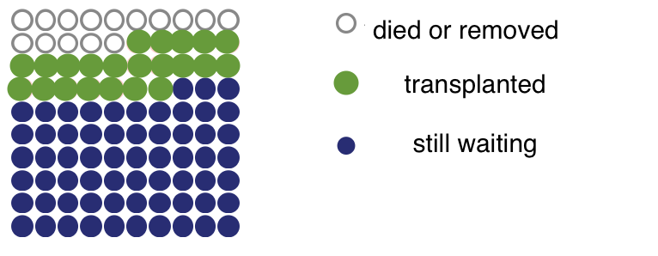
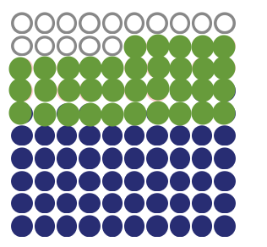
What might happen if you are listed for a LUNG transplant ?
What might happen if you join the transplant waiting list?
This graph shows what happened to people ‘like you’ in the past (eg same blood group, age, disease etc.).
It shows how many people might be transplanted over 5 years
This is an estimate, an average, there are other factors about you that can influence these results and make the numbers higher or lower. eg whether you have other conditions not included in the tool
10 died or were removed
10 were transplanted
80 are still waiting
15 died or were removed
22 were transplanted
63 are still waiting
15 died or were removed
35 were transplanted
50 are still waiting
To find out more about the data and models behind the calculator click here
In Year 1
by the end of Year 3
by the end of Year 5
Notes:
VERSION 3 – ROUND 3 – Icon Array – competing risks
P11
Changed “example” to “display”
Chante ‘what might happen” to “if we took”
This display shows what might happen if we took 100 patients who had input the same details as you, from the point they join the waiting list.
Changed years to 1, 3, 5 to marry with the other examples.
Did NOT change the numbers in those years (too tricky on this visual!)
ROUND 2
Removed “these are cumulative totals”

Slide 10
Survival Post Transplant (Graft)

Slide 11
How long might my new kidney last if I have a LIVING DONOR?
This graph shows what happened to people ‘like you’ in the past (eg same blood group, age, disease etc.).
It shows how many kidneys are still working over time.
This is an estimate, an average, there are other factors about you that can influence these results and make the numbers higher or lower. eg whether you have other conditions not included in the tool, lifestyle factors post transplant
NB this is national data, it is not hospital specific. This is because there is not yet enough data to be centre specific
why does the graph stop at year 5?
Kidney allocation changed in 2010 and again in 2014 and as such the data isn’t reliable enough to show 10 year outcomes
As time passes we will be able to add in more years
_______________________
The overall average at
10 years
78% were still working
(data from 2008)
________________________________________
THESE GRAPHS CAN BE AREA GRAPHS BECAUSE WE’RE NOW NOT SHOWING LIVING AND DECEASED ON THE SAME GRAPH
Notes:
94% living donor at 5 years
91% deceased donor at 5 years
P11
Did not like this slide at all ! (looking at lung survival)
Kidney patient, did not like seeing poor outcomes
Result of this interview – change the outcomes of survival to more closely reflect what happens in kidneys!
(option of dialysis, second transplant, fewer deaths by 5 years, better outcomes generally)
Our tool can provide PATIENT SURVIVAL and GRAFT SURVIVAL
Test to have them on the same graph? Or two separate graphs?
CHANGES -
Changed wording of ‘why does the data stop at 5 years’ to ‘why does the graph stop at year 5’
Changed graph to show living donor / deceased donor graft survival
Changed title to “how long might my kidney last”

Slide 12
How long might my new kidney last if I have a deceased DONOR?
This graph shows what happened to people ‘like you’ in the past (eg same blood group, age, disease etc.).
It shows how many kidneys are still working over time.
This is an estimate, an average, there are other factors about you that can influence these results and make the numbers higher or lower. eg whether you have other conditions not included in the tool, lifestyle factors post transplant
Why are year 5 – 10 in a different colour?
Kidney allocation changed in 2010 and again in 2014 and as such the data for years 5–10 is not the same as years 1-5.
This means that the results for years 5-10 years are not as reliable.
_______________________
Notes:
94% living donor at 5 years
91% deceased donor at 5 years
P11
Did not like this slide at all ! (looking at lung survival)
Kidney patient, did not like seeing poor outcomes
Result of this interview – change the outcomes of survival to more closely reflect what happens in kidneys!
(option of dialysis, second transplant, fewer deaths by 5 years, better outcomes generally)
Our tool can provide PATIENT SURVIVAL and GRAFT SURVIVAL
Test to have them on the same graph? Or two separate graphs?
CHANGES -
Changed wording of ‘why does the data stop at 5 years’ to ‘why does the graph stop at year 5’
Changed graph to show living donor / deceased donor graft survival
Changed title to “how long might my kidney last”

Slide 13
How long might my new kidney last if I have a deceased DONOR?
This graph shows what happened to people ‘like you’ in the past (eg same blood group, age, disease etc.).
It shows how many kidneys are still working over time.
This is an estimate, an average, there are other factors about you that can This is an estimate, an average, there are other factors about you that can influence these results and make the numbers higher or lower. eg whether you have other conditions not included in the tool, lifestyle factors post transplant
Currently showing LIVING and DECEASED
BUT LIVING IS NATIONAL DATA
AND DECEASED IS HOSPITAL SPECIFIC
WHAT DO WE WANT – TWO SEPARATE DISPLAYS ??
OR A DISPLAY WITH THE CAVEAT THAT THE LIVING DATA ISN’T THE SAME?
Y
EXTRA Living Donor Kidney still working
Deceased Donor Kidney still working
Removed from the list or died
Year 1
By the end of Year 5
By the end of Year 10

Slide 14
Survival Post Transplant (Person)

Slide 15
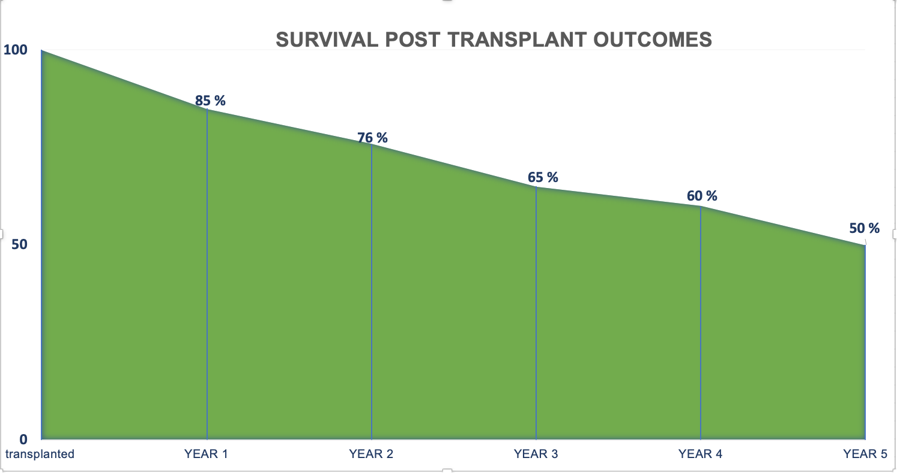
How long might I live if I have a kidney transplant ?
%
This graph shows what happened to people ‘like you’ in the past (eg same blood group, age, disease etc.).
.
This is an estimate, an average, there are other factors about you that can influence these results and make the numbers higher or lower. eg whether you have other conditions not included in the tool, lifestyle factors post transplant
% people surviving post transplant
%
Time
Transplanted
Notes:
VERSION 3 – ROUND 3
Trying with out grey area entirely

Slide 16
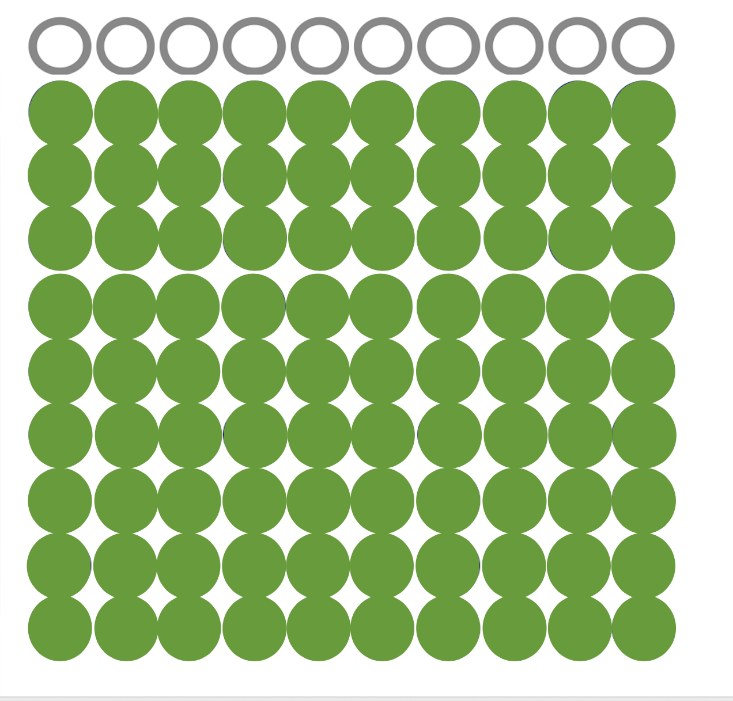
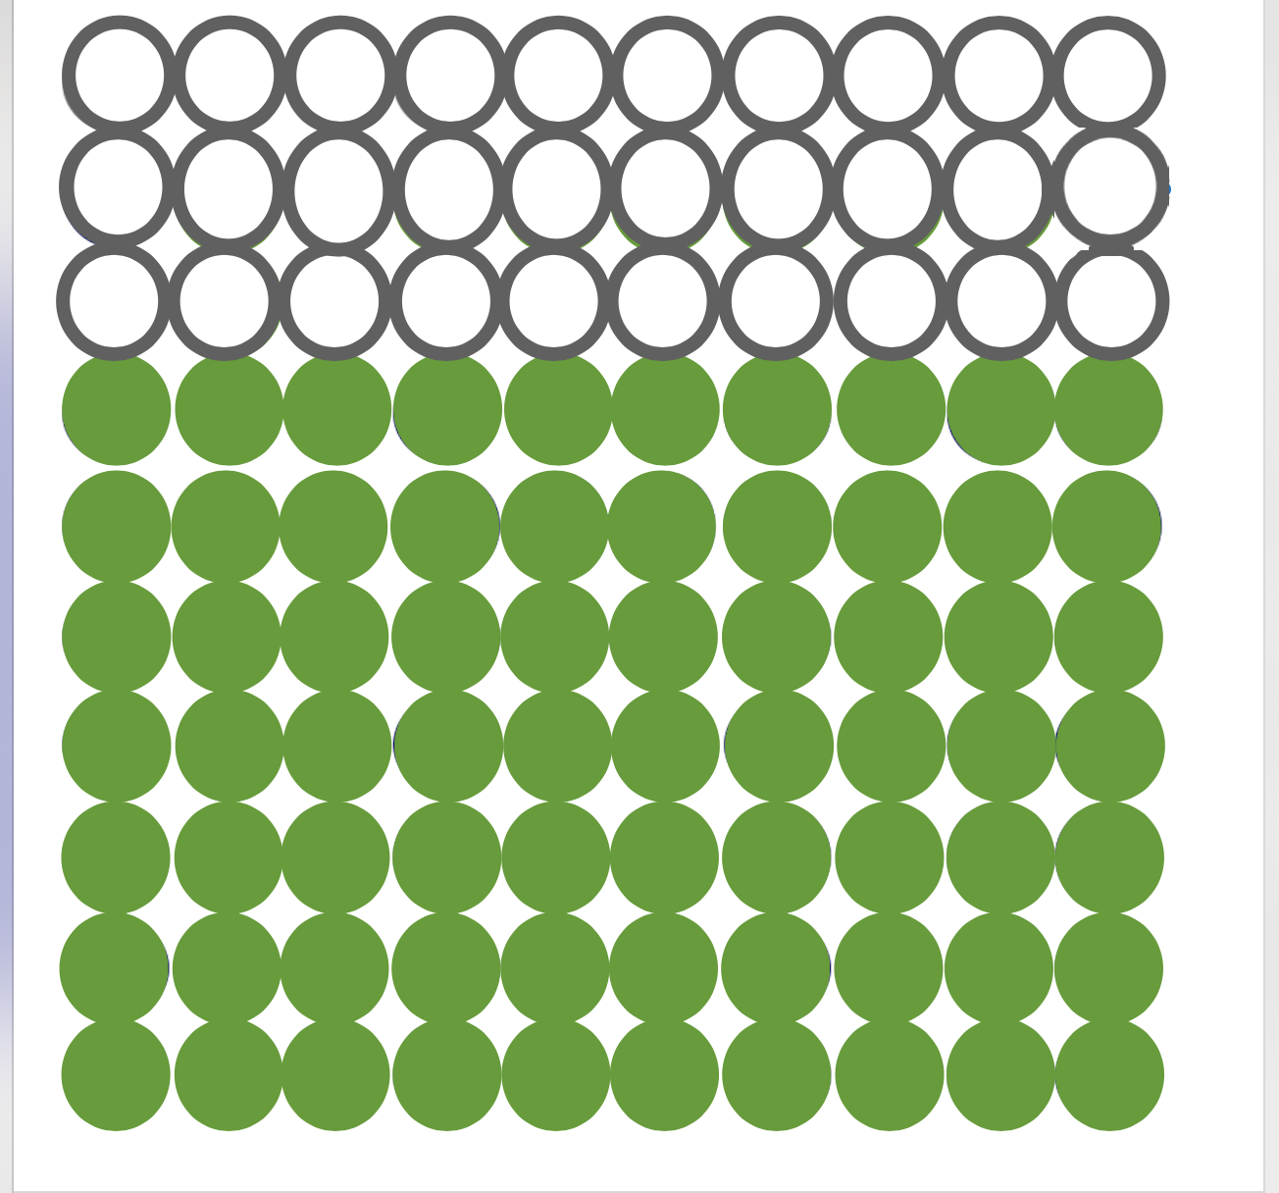
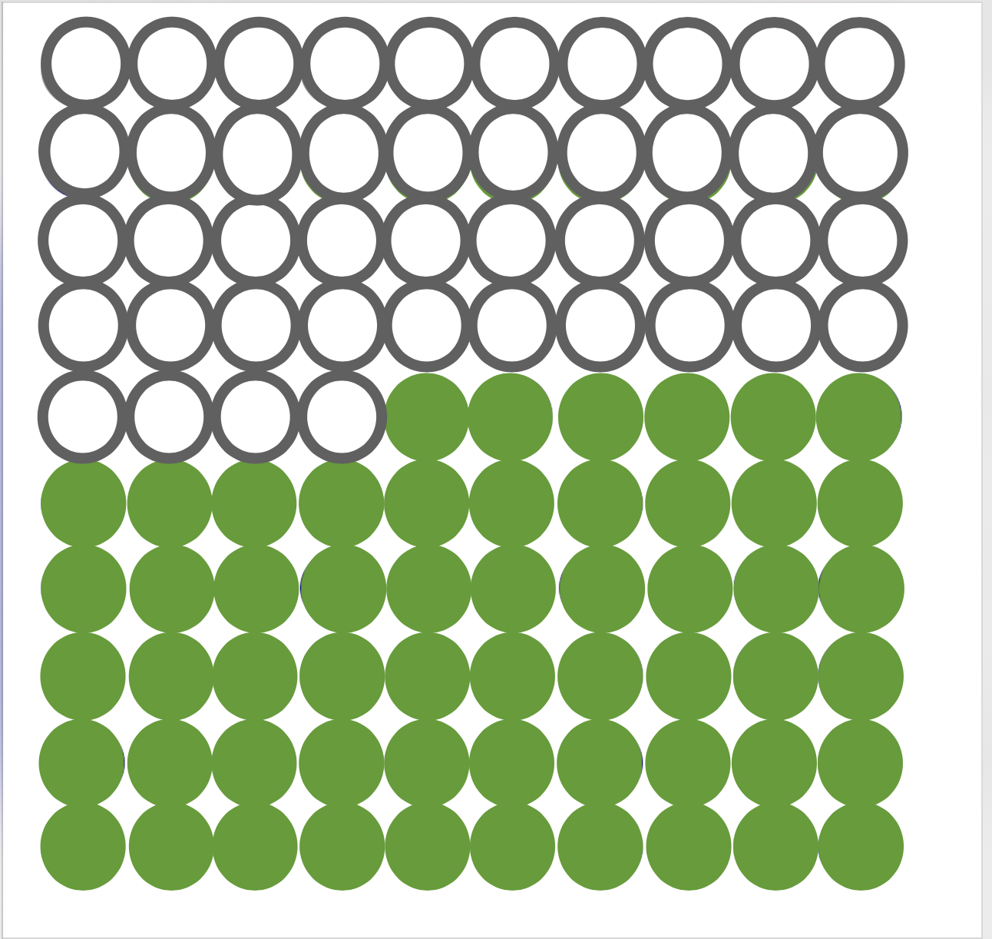
How long might I live if I have a kidney transplant?
This shows outcomes we would expect for an example 100 transplant patients, who input the same details as you, after surgery.
died
still alive
By the end of Year 1
By the end of Year 3
By the end of Year 5
Kidney allocation changed in 2010 and again in 2014 and as such the data isn’t reliable enough to show 10 year outcomes
As time passes we will be able to add in more years
Notes:
VERSION 3 – ROUND 3
Alternative wording :
This shows what we would expect to happen if we took 100 people like you (same age, disease etc)

Slide 17
END – THANK YOU

Slide 18
Useful Slides
How many people are on the list / have been transplanted?
Why do transplanted kidneys fail?
What medications might I be on?
How often do I need to come into the hospital after transplant
Donor Decisions
What if my new kidney fails?
How did we work out the numbers ?

Slide 19
How many people are on the kidney transplant waiting list?
(April 2019 – March 2020)
Total number of kidney patients on the waiting list 4960
Total number of transplants carried out 2280
Total number of deceased donor transplants 1474
Total number of living donor transplants 982
Notes:
P11
Suggested to Add an intro slide of how many people are on the waiting list now, were transplanted last year, # donors

Slide 20
Why do transplanted kidneys fail?
Chronic rejection
Acute rejection
Failure to take medication properly
Blood clots
Fluid collection
Infection
side effects of drugs
Recurrent disease

Slide 21
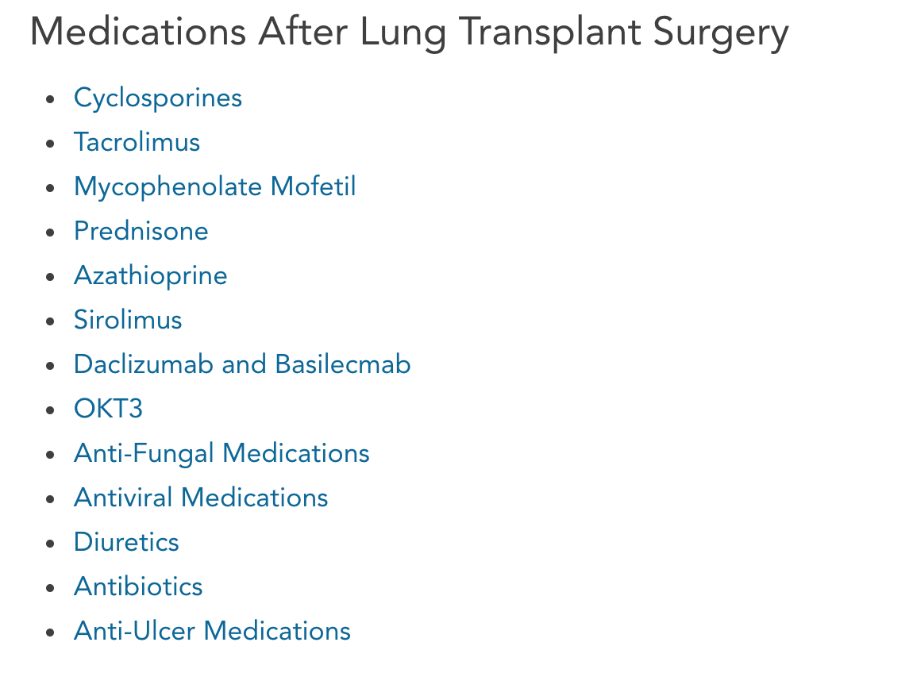
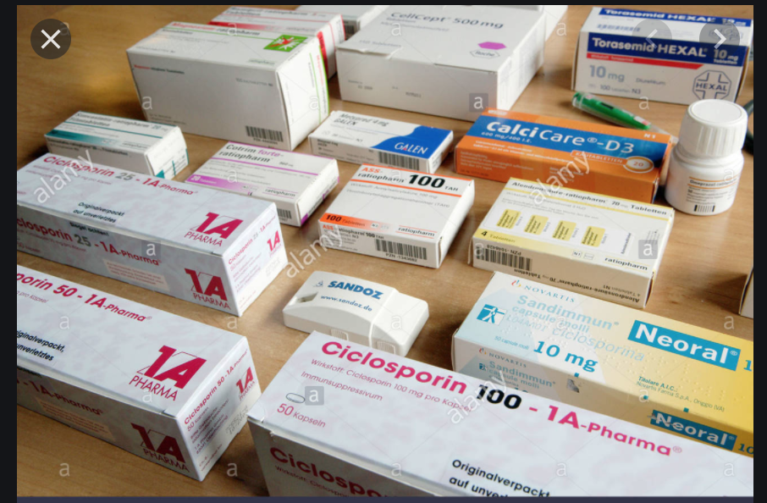
Anti-rejection medications

Slide 22
Visits to hospital after transplant
1st month - once a week, every week
2nd month - once a week, every other week
3rd month - once a week, every other week
4th month - once a week, every 4 weeks
Once a week every 4 weeks for 1 more year
Then every 3 months for life

Slide 23
Lung Transplant Donor Decisions
Recent or ex smoker what does this mean?
Older donor (>60 years)
Donor with a malignancy that has very low risk of transmission to me
Bacterial or viral infection considered to be low risk to me
High risk sexual behaviour or intravenous drug use

Slide 24
What are my options if my new kidney fails?
Acute Rejections Chronic Rejection
What to look out for What to look out for
Peritoneal Dialysis (PD)
always done at home - that means no regular need to go to hospital for treatment
Haemodialysis (HD)
There are 2 ways of doing HD
HD (haemodialysis). Done at hospital. People go to hospital 3 times a week (every week) for a 4 hour session.
HHD (home haemodialysis). HD done at home after training people how to do it. All supplies are provided free. Saves people needing to stick to inflexible hospital appointments

Slide 25
How do we calculate these results?
NHS BT (blood and transplant) hold all the data and statistics relating to transplant in the UK.
Their statisticians have used the data to create these models (the maths behind the calculator)
They looked at all the patients who were listed or had a transplant between 2004 and 2014
We then made some calculations to work out what happened to certain groups
For example, we looked at how long people with certain blood groups might wait for a transplant
Or how long do people survive post transplant from different disease groups
We then modelled that into the calculator so that when you input various factors, such as age, disease, blood group etc, the tool will calculate what happened to people with those characteristics between 2004 and 2014 and that’s the result you see.
The data set we used (patients between 2004 and 2014) will be updated regularly. We will change the data set every year so that it’s kept up to date.
The model, or the maths we use to make the calculations, will be revisited and potentially revised every 3 or 5 years
So the tool will always be as relevant and up to date as possible.

Slide 26
There’s a lot of information to take in
aim the tool - help clinicians explain transplant outcomes and help patients understand
Consultant Respiratory Physician
We don't have a crystal ball, but we can present you with a range of statistics, and information that help us to inform the decision
…The median survival, so how long do 50% of people survive after the diagnosis, is about 3 ½ years.
So you’ve clearly done better than this (double)…I think you’re at the point where your lung capacity is around about 20% of lung function. You’ve lost 80% of your lungs.
…If you were to imagine that you don’t have the transplant, there’s a strong possibility that in the next 2 years you would die of this disease. I would put that above 50%, so fairly significant
…Let’s imagine you were coming for a transplant. Two things people want to know about is LENGTH and QoL
In terms of length of life. If you were to come in for a transplant tomorrow, what would be the chances that you would be alive at the end of 1 month
That’s about 90-95%. There is a 5-10% chance that you might die in that period. But equally there’s a 90-95% chance that you’ll live.
At the end of 1 year, it’s about 80-85%, chance of being alive.
For patients who don’t make it to the end of the year, the risk is about 15-20%.
You’ve got 80% chance you’ll make it to the end of the year.
And then at 5 years, for someone of your age and disease condition, it should be around 55-60%
So it does mean that you do have roughly 40% chance of not being alive.
But you’ve got a 55-60% chance of being alive
Unwell
Tired
Overwhelmed
Anxious
Have difficulty concentrating
Intimidated
Worried
Stressed
Notes:
Because I just want to quickly show you a couple of examples of from lung and kidney transplant consultations with doctors
You don’t need to read the slide, I just wanted to point out the number of numbers
And I don’t know about you but sitting listening to me babble on for 10 minutes with the help of slides and being (hopefully engaged (and not ill), is hard enough – being ill, scared and without visual aids, I would find this quite difficult to follow)

Slide 27
There’s a lot of information to take in
Nephrology - surgeon
…if you were to have a kidney from a deceased donor, I would say that one year after the
transplant there is probably a 90% chance that you will have a kidney that will still working and
about 10 years down the line, there would be a 50% chance that you will have a kidney that still
working.
There are all sort of reasons why a kidney can last a year or more than 10 years. It might be, 2 out of 100 kidneys that we put in never work if they come from a deceased donor, we use them under the expectation that they are going to work but… coming from a person who has died, being transplanted, that kidney might never work.
But in the first year there might be a problem with a blood vessel, or rejection… so 10 out of 100 kidneys from a deceased donor might not work after one year. But 9 out of 10 will be working after a year and half will be working after 10 years. In terms of deceased donation, there are more people waiting for kidney than there are kidneys available. So, 500 – 600 kidneys donated each year from a deceased donor when there is about 6000 – 7000 people on the waiting list. … we think that the average waiting -we call it the median waiting time- would be about 620 days, so about 20 to 21 months, so, that is the median waiting time. What do I mean by that?
So, if I had 100 patients and put them on the list today 50 of them will be transplanted in 600 – 650 days but 50 of them will be still waiting beyond that time, And there is all sort of things that influence how long people wait, including things like your blood group, your tissue type, whether you have got any of these antibodies that we talked about etc. ok? But the average waiting time, in your head is about 20 to 21 months.
aim the tool - help clinicians explain transplant outcomes and help patients understand
Unwell
Tired
Overwhelmed
Anxious
Have difficulty concentrating
Intimidated
Worried
Stressed
PAIN
Notes:
this is an example from a kidney surgeon consult
frequencies (10 out 100), percentages, 50%, number of DAYS 620 days (how long is that?....) Median outcomes
Back to our tool
One of the ways we hope to help patients is by reducing the need for them to process or even understand this kind of information in the consult itself
- we will be able to make these numbers more relevant and personalised to the patient
with the option to take a printed copy home with them so they dont need to remember
.

